Slide 1
Introduction to Data Structure and Algorithms

Slide 2
Algorithm Analysis

Slide 3
Algorithms and Complexity
An algorithm is a well-defined list of steps for solving a particular problem
One major challenge of programming is to develop efficient algorithms for the processing of our data
The time and space it uses are two major measures of the efficiency of an algorithm
The complexity of an algorithm is the function, which gives the running time and/or space in terms of the input size

Slide 4
Algorithm Analysis
Space complexity
  How much space is required
Time complexity
  How much time does it take to run the algorithm

Slide 5
Space Complexity
Space complexity = The amount of memory required by an algorithm to run to completion
  the most often encountered cause is “memory leaks” – the amount of memory required larger than the memory available on a given system
Some algorithms may be more efficient if data completely loaded into memory
  Need to look also at system limitations
  e.g. Classify 2GB of text in various categories – can I afford to load the entire collection?

Slide 6
Space Complexity (cont…)
Fixed part: The size required to store certain data/variables, that is independent of the size of the problem:
  e.g. name of the data collection
Variable part: Space needed by variables, whose size is dependent on the size of the problem:
  - e.g. actual text
  - load 2GB of text VS. load 1MB of text

Slide 7
Time Complexity
Often more important than space complexity
  space available tends to be larger and larger
  time is still a problem for all of us
3-4GHz processors on the market
  still …
  researchers estimate that the computation of various transformations for 1 single DNA chain for one single protein on 1 TerraHZ computer would take about 1 year to run to completion
Algorithms running time is an important issue

Slide 8
Complexity of Algorithms
Analysis of algorithms is a major task in computer science.
In order to compare algorithms, we must have some criteria to measure the efficiency of our algorithms
Suppose M is an algorithm, and suppose n is the size of the input data.
The time and space used by the algorithm M are the two main measures for the efficiency of M. The time is measured by counting the number of key operations

Slide 9
Complexity of Algorithms (Cont..)
That is because key operations are so defined that the time for the other operations is much less than or at most proportional to the time for the key operations.
The space is measured by counting the maximum of memory needed by the algorithm
The complexity of an algorithm M is the function f(n) which gives the running time and/or storage space requirement of the algorithm in term of the size n of the input data
Frequently, the storage space required by an algorithm is simply a multiple of the data size n
Accordingly, unless otherwise stated or implied, the term "complexity" shall refer to the running time of the algorithm

Slide 10
Question that will be answered
What is a “good” or "efficient" program?
How to measure the efficiency of a program?
How to analyze a simple program?
How to compare different programs?
What is the big-O notation?
What is the impact of input on program performance?
What are the standard program analysis techniques?
Do we need fast machines or fast algorithms?

Slide 11
Which is Better ?
The running time of a program
Program easy to understand?
Program easy to code and debug?
Program making efficient use of resources?
Program running as fast as possible?

Slide 12
Measuring Efficiency?
Ways of measuring efficiency:
  Run the program and see how long it takes
  Run the program and see how much memory it uses
Lots of variables to control:
  What is the input data?
  What is the hardware platform?
  What is the programming language/compiler?
  Just because one program is faster than another right now, means it will always be faster?

Slide 13
Measuring Efficiency?
Want to achieve platform-independence
Use an abstract machine that uses steps of time and units of memory, instead of seconds or bytes
  each elementary operation takes 1 step
  each elementary instance occupies 1 unit of memory

Slide 14
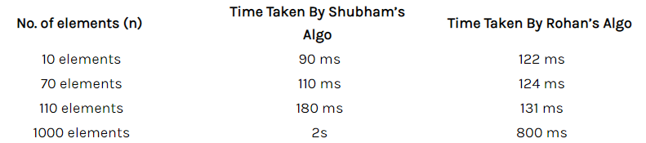
Running Time
Let's understand this concept with the help of an example:
Consider two developers Shubham and Rohan, who created an algorithm to sort ‘n’ numbers independently.
When I made the program run for some input size n, the following results were recorded:
Which one is best?

Slide 15
Running Time
Problem: average of elements
  Given an array X
  Compute the array A such that A[i] is the average of elements X[0] … X[i], for i=0..n-1
Sol 1
  At each step i, compute the element X[i] by traversing the array A and determining the sum of its elements, respectively the average
Sol 2
  At each step i update a sum of the elements in the array A
  Compute the element X[i] as sum/I
Which solution to choose?

Slide 16
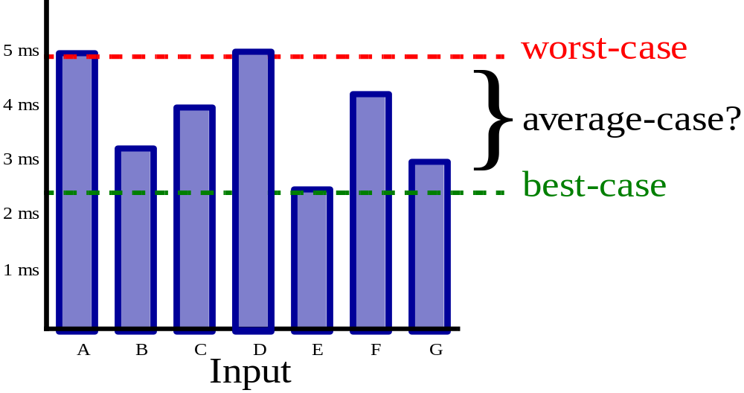
Running Time (cont…)
Suppose the program includes an if-then statement that may execute or not: → variable running time
Typically algorithms are measured by their worst case

Slide 17
A Simple Example?
// Input: int A[N], array of N integers
// Output: Sum of all numbers in array A
int Sum(int A[], int N) {
int s=0;
for (int i=0; i< N; i++)
s = s + A[i];
return s;
}
How should we analyze this?

Slide 18
A Simple Example
Analysis of Sum
1.) Describe the size of the input in terms of one ore more parameters:
  Input to Sum is an array of N ints, so size is N.
2.) Then, count how many steps are used for an input of that size:
  A step is an elementary operation such as
  +, <, =, A[i]

Slide 19
Analysis of Sum (2)
// Input: int A[N], array of N integers
// Output: Sum of all numbers in array A
int Sum(int A[], int N {
int s=0;
for (int i=0; i< N; i++)
s = s + A[i];
return s;
}
1
2
3
4
5
6
7
1,2,8: Once
3,4,5,6,7: Once per each iteration
of for loop, N iteration
Total: 5N + 3
The complexity function of the
algorithm is : f(N) = 5N +3
8

Slide 20
Analysis: A Simple Example
How 5N + 3 Grows
Estimated running time for different values of N:
N = 10 => 53 steps
N = 100 => 503 steps
N = 1,000 => 5003 steps
N = 1,000,000 => 5,000,003 steps
As N grows, the number of steps grow in linear proportion to
N for this Sum function.

Slide 21
Analysis: A Simple Example
What dominates?
What about the 5 in 5N+3? What about the +3?
As N gets large, the +3 becomes insignificant
5 is inaccurate, as different operations require varying
amounts of time
What is fundamental is that the time is linear in N.
Asymptotic Complexity: As N gets large, concentrate on the
highest order term:
Drop lower order terms such as +3
Drop the constant coefficient of the highest order term i.e. N

Slide 22
Analysis: A Simple Example
Asymptotic Complexity
The 5N+3 time bound is said to "grow asymptotically" like N
This gives us an approximation of the complexity of the
algorithm
Ignores lots of (machine dependent) details, concentrate
on the bigger picture

Slide 23
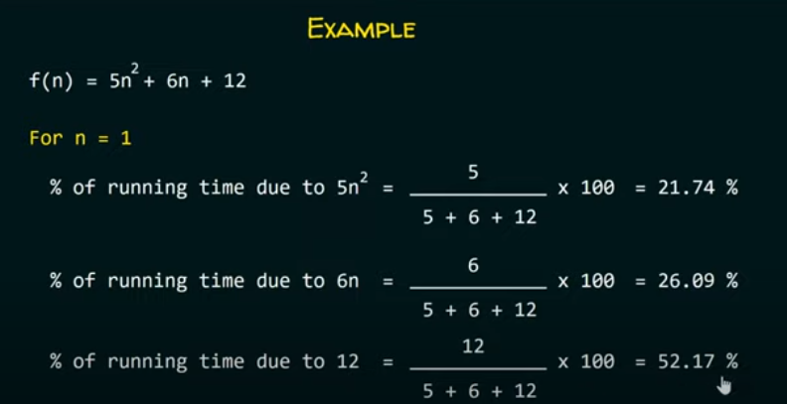
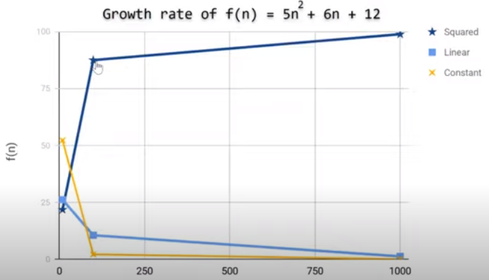
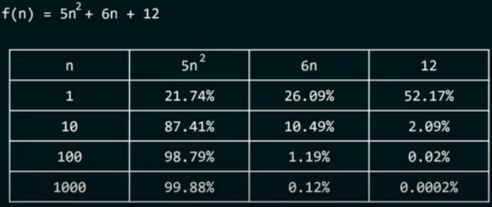
A Simple Example

Slide 24

Algorithm Analysis
(Asymptotic Analysis)

Slide 25
Asymptotic Complexity
Complexity (time or storage) of an algorithm is usually a function of n (such as polynomial, exponential, logarithmic etc.)
Behaviour of this function (i.e. how the function changes with n) is usually expressed in terms of one or more standard function(s)
Expressing the complexity function with reference to other known function(s) is called asymptotic complexity

Slide 26
Classifying Functions by Their Asymptotic Growth
Asymptotic growth : The rate of growth of a function
Given a particular differentiable function f(n), all other differentiable functions fall into three classes:
    growing with the same rate
    growing faster
    growing slower

Slide 27
Asymptotic Notations
Asymptotic notations are the mathematical notations used to describe the running time of an algorithm when the input tends towards a particular value or a limiting value.
For example: In bubble sort, when the input array is already sorted, the time taken by the algorithm is linear i.e. the best case.
But, when the input array is in reverse condition, the algorithm takes the maximum time (quadratic) to sort the elements i.e. the worst case.
When the input array is neither sorted nor in reverse order, then it takes average time. These durations are denoted using asymptotic notations.
There are mainly three asymptotic notations

Slide 28
Asymptotic Notations
There are mainly three asymptotic notations:
Big-O notation
Omega notation
Theta notation

Slide 29
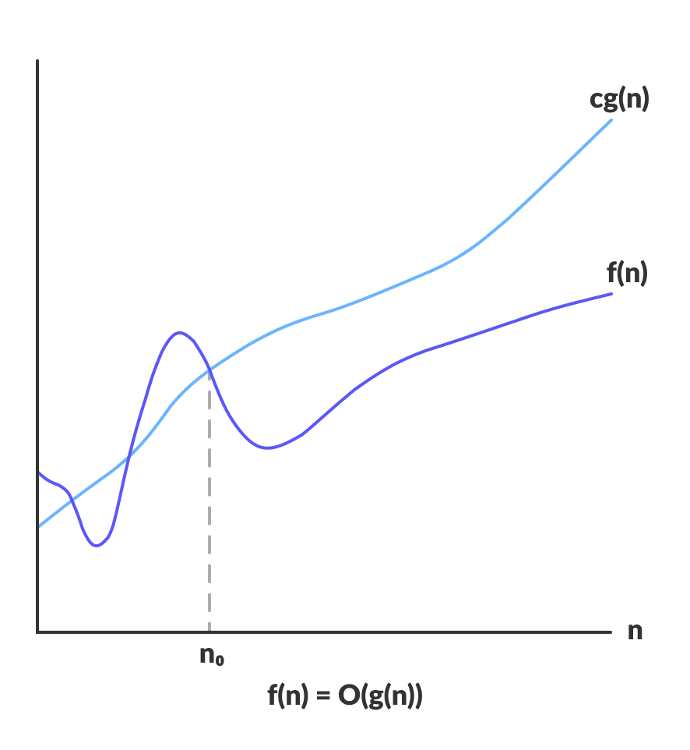
Big O
Big-O notation represents the upper bound of the running time of an algorithm. Thus, it gives the worst-case complexity of an algorithm.

Slide 30
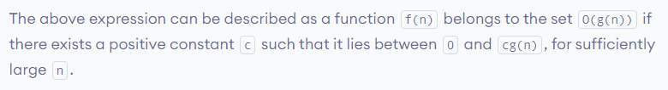
Big O
Big-O notation represents the upper bound.

Slide 31
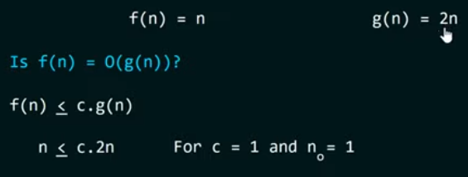
Big O (Proof)

Slide 32
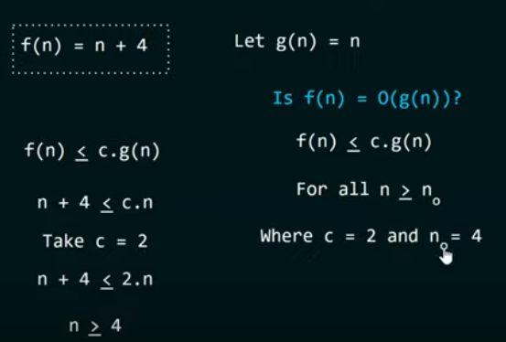
Big O (Proof)

Slide 33
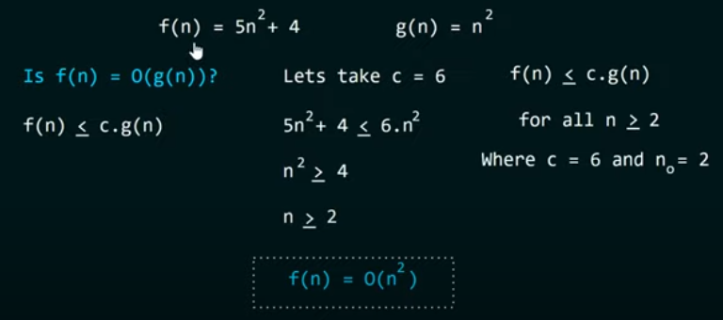
Big O (Proof)

Slide 34
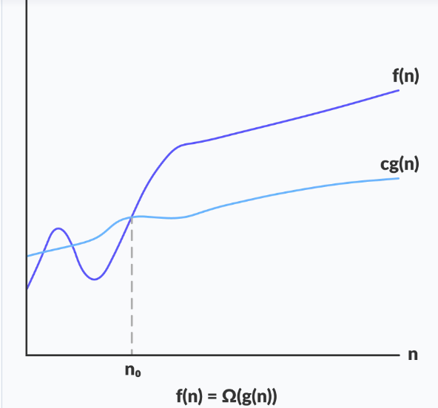
Omega Notation (Ω-notation)
Omega notation represents the lower bound of the running time of an algorithm. Thus, it provides the best case complexity of an algorithm.

Slide 35
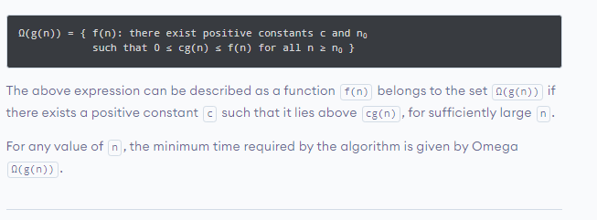
Big Omega

Slide 36
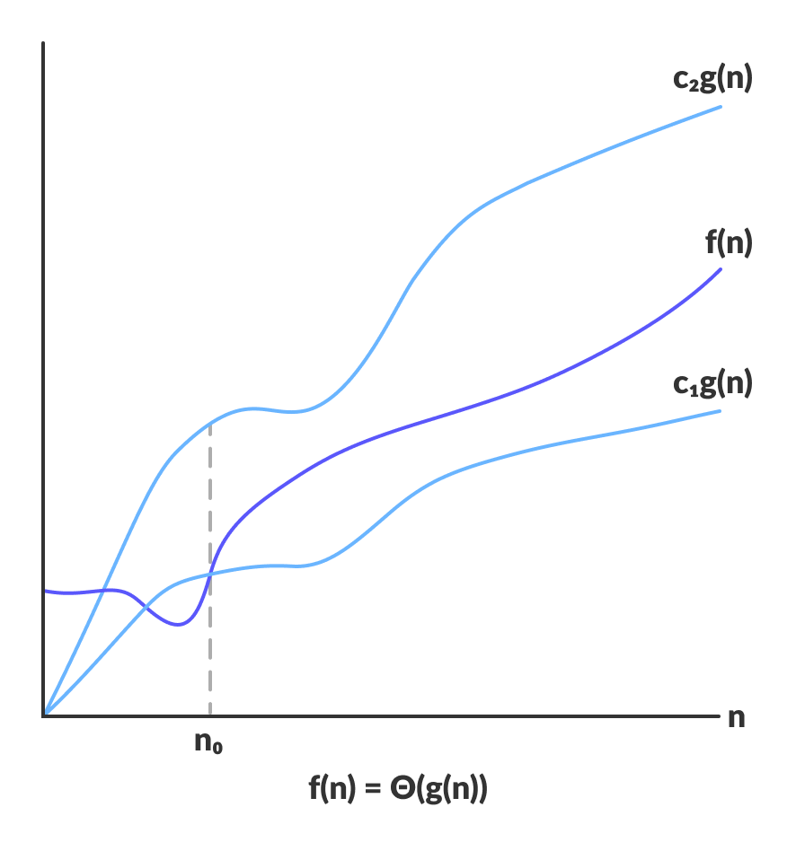
Theta Notation (Θ-notation)
Theta notation encloses the function from above and below. Since it represents the upper and the lower bound of the running time of an algorithm, it is used for analyzing the average-case complexity of an algorithm.

Slide 37
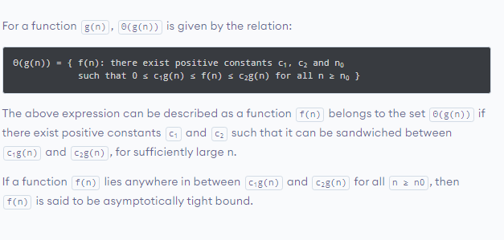
Theta Notation (Θ-notation)

Slide 38
Little o
    f(n) grows slower than g(n)
(or g(n) grows faster than f(n))
if
    lim( f(n) / g(n) ) = 0, n → ∞
Notation: f(n) = o( g(n) )
pronounced "little o"

Slide 39
Little omega
    f(n) grows faster than g(n)
(or g(n) grows slower than f(n))
if
    lim( f(n) / g(n) ) = ∞, n -> ∞
Notation: f(n) = ω (g(n))
pronounced "little omega"

Slide 40
Algorithms with Same Complexity
Two algorithms have same complexity,
if the functions representing the number of operations have
same rate of growth.
Among all functions with same rate of growth we choose the simplest one to represent the complexity.

Slide 41
Examples
Θ(n³): n³
5n³+ 4n
105n³+ 4n² + 6n
Θ(n²): n²
5n²+ 4n + 6
n² + 5
Θ(log n): log n
log n²
log (n + n³)

Slide 42
Comparing Functions
same rate of growth: g(n) = Θ(f(n))
different rate of growth:
either g(n) = o (f(n))
g(n) grows slower than f(n),
and hence f(n) = ω(g(n))
or g(n) = ω (f(n))
g(n) grows faster than f(n),
and hence f(n) = o(g(n))

Slide 43
The Big-Omega Notation
The inverse of Big-O is Ω
If g(n) = O(f(n)),
then f(n) = Ω (g(n))
f(n) grows faster or with the same rate as g(n): f(n) = Ω (g(n))

Slide 44
The Big O Notation
f(n) = O(g(n))
if f(n) grows with
same rate or slower than g(n).

Slide 45
BIG O Notation

Slide 46
The Big O Notation
Big O notation is used in Computer Science to describe the performance or complexity of an algorithm.
Big O specifically describes the worst-case scenario, and can be used to describe the execution time required or the space used (e.g. in memory or on disk) by an algorithm
Big O notation characterizes functions according to their growth rates: different functions with the same growth rate may be represented using the same O notation

Slide 47
Big O Notation
It is used to describe an algorithm's usage of computational resources: the worst case or average case or running time or memory usage of an algorithm is often expressed as a function of the length of its input using Big O notation
Simply, it describes how the algorithm scales (performs) in the worst case scenario as it is run with more input

Slide 48
For example
If we have a sub routine that searches an array item by item looking for a given element
The scenario that the Big-O describes is
  when the target element is last (or not present at all).
This particular algorithm is O(N) so the same algorithm working on an array with 25 elements should take approximately 5 times longer than an array with 5 elements

Slide 49
Big O Notation
This allows algorithm designers to predict the behavior of their algorithms and to determine which of multiple algorithms to use, in a way that is independent of computer architecture or clock rate
A description of a function in terms of big O notation usually only provides an upper bound on the growth rate of the function

Slide 50
Big O Notation
In typical usage, the formal definition of O notation is not used directly; rather, the O notation for a function f(x) is derived by the following simplification rules:
  If f(x) is a sum of several terms, the one with the largest growth rate is kept, and all others are omitted
  If f(x) is a product of several factors, any constants (terms in the product that do not depend on x) are omitted

Slide 51
For example
Let f(x) = 6x⁴ − 2x³ + 5, and suppose we wish to simplify this function, using O notation, to describe its growth rate as x approaches infinity.
This function is the sum of three terms:
  6x⁴
  −2x³
  5

Slide 52
…
Of these three terms, the one with the highest growth rate is the one with the largest exponent as a function of x, namely 6x⁴.
Now one may apply the second rule: 6x⁴ is a product of 6 and x⁴ in which the first factor does not depend on x.
Omitting this factor results in the simplified form x⁴.
Thus, we say that f(x) is a big-o of (x⁴) or mathematically we can write f(x) = O(x⁴).

Slide 53
Standard Analysis Techniques
Constant Time Statements
Simplest case: O(1) time statements
Assignment statements of simple data types
int x = y;
Arithmetic operations:
x = 5 * y + 4 - z;
Array referencing:
A[j] = 5;
Array assignment:
∀ j, A[j] = 5;
Most conditional tests:
if (x < 12) ...

Slide 54
Standard Analysis Techniques
Analyzing Loops
Any loop has two parts:
1. How many iterations are performed?
2. How many steps per iteration?
int sum = 0,j;
for (j=0; j < N; j++)
sum = sum +j;
- Loop executes N times (0..N-1)
- 4 = O(1) steps per iteration
- Total time is N * O(1) = O(N*1) = O(N)

Slide 55
Standard Analysis Techniques
Analyzing Loops (2)
What about this for-loop?
int sum =0, j;
for (j=0; j < 100; j++)
sum = sum +j;
- Loop executes 100 times
- 4 = O(1) steps per iteration
- Total time is 100 * O(1) = O(100 * 1) = O(100) = O(1)
PRODUCT RULE

Slide 56
Standard Analysis Techniques
Analyzing Loops (3)
What about while-loops?
Determine how many times the loop will be executed:
bool done = false;
int result = 1, n;
scanf("%d", &n);
while (!done){
result = result *n;
n--;
if (n <= 1) done = true;
}
Loop terminates when done == true, which happens
after N iterations. Total time: O(N)

Slide 57
Standard Analysis Techniques
Nested Loops
Treat just like a single loop and evaluate each
level of nesting as needed:
int j,k;
for (j=0; j<N; j++)
for (k=N; k>0; k--)
sum += k+j;
Start with outer loop:
- How many iterations? N
- How much time per iteration? Need to evaluate inner loop
Inner loop uses O(N) time
Total time is N * O(N) = O(N*N) = O(N²)

Slide 58
Analysing an Algorithm
Loop index depends on outer loop index
  for(j=0;j<n;j++)
  for(k=0;k<j;k++){
  s;
  }
  Inner loop executed
    1, 2, 3, …., n times
  Complexity O(n²)
Distinguish this case -
where the iteration count increases (decreases) by a constant ⬅ O(n^{k})
from the previous one -
where it changes by a factor ⬅ O(log n)
n
n(n+1)
Σ i =
i=1
2

Slide 59
Standard Analysis Techniques
Nested Loops (2)
What if the number of iterations of one loop depends on the
counter of the other?
int j,k;
for (j=0; j < N; j++)
for (k=0; k < j; k++)
sum += k+j;
Analyze inner and outer loop together:
- Number of iterations of the inner loop is:
0 + 1 + 2 + ... + (N-1) = O(N²)

Slide 60
Standard Analysis Techniques
Sequence of Statements
For a sequence of statements, compute their complexity
Functions individually and add them up
for (j=0; j < N; j++)
for (k =0; k < j; k++)
sum = sum + j*k;
for (l=0; l < N; l++)
sum = sum -l;
printf("sum is now %f", sum);
Total cost is O(N²) + O(N) +O(1) = O(N²)
SUM RULE

Slide 61
Analysing an Algorithm
Loop index doesn’t vary linearly
  h = 1;
  while ( h <= n ) {
  s;
  h = 2 * h;
  }
  h takes values 1, 2, 4, … until it exceeds n
  There are 1 + log₂n iterations
  Complexity O(log n)

Slide 62
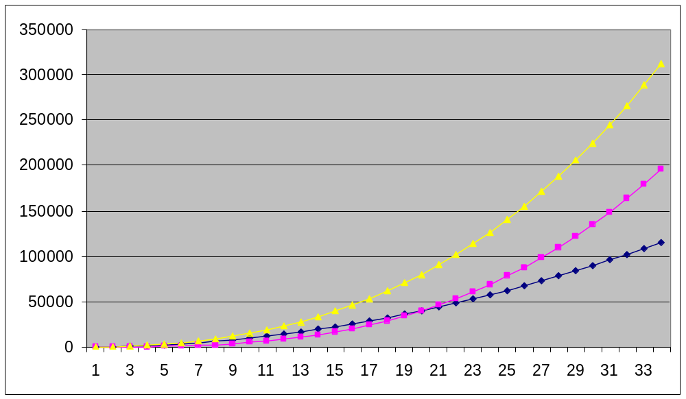
Big-O Notation
100n²
5n³
100n² + 5n³
5n⁴

Slide 63
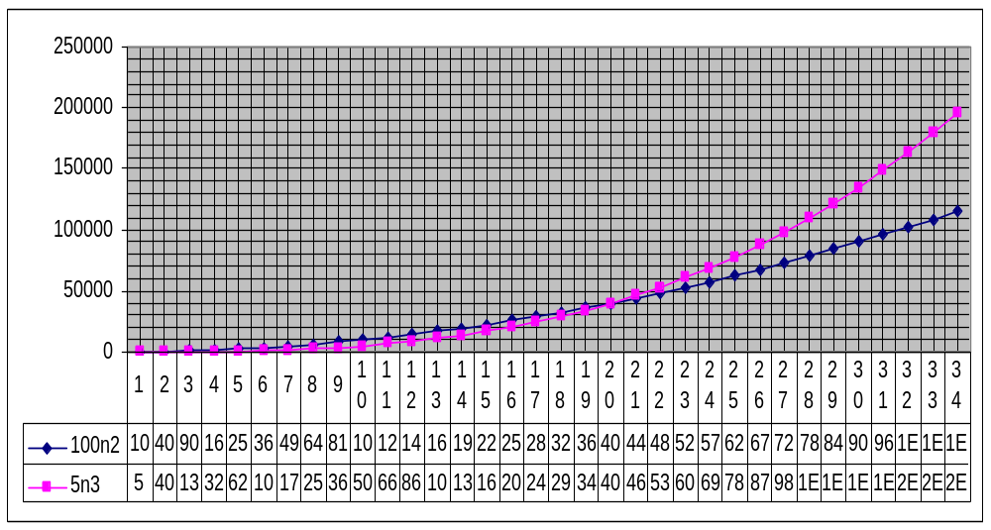
Comparing Functions
100n² Vs 5n³, which one is better?

Slide 64
Comparing Functions
Why is this useful?
As inputs get larger, any algorithm of a smaller order will
be more efficient than an algorithm of a larger order
0.05 N² = O(N²)
3N = O(N)
Time (steps)
N = 60
Input (size)

Slide 65
Growth of Function
Most algorithms have a primary parameter N that affects the running time most significantly.
The parameter N might be the
Degree of a polynomial
The size of a file to be stored or searched,
The number of characters in a text string,
Some other abstract measure of the size of the problem being considered.
It is most often directly proportional to the size of the data being processed.

Slide 66
Growth of Function
The goal is to express the resource requirements of our programs (most often running time) in terms of N, using mathematical formulas that are simple as possible and that are accurate for large values of the parameters.
The algorithms typically have running times proportional to one of the functions described in the following slides.

Slide 67
Growth of Function
Running Time | Explanation
1 | Most instructions of most programs are executed once or at most only a few times. If all the instructions of a program have this property, we say that the program’s running time is constant.
log N | When the running time of a program is logarithmic, the program gets slightly slower as N grows. This running time commonly occurs in programs that solve a big problem by transforming into a series of smaller problems, cutting the problem size by some constant fraction at each step.

Slide 68
Growth of Function
Running Time | Explanation
N | When the running time of a program is linear, it is generally the case that a small amount of processing is done on each input element.
N log N | The N log N running time arises when algorithms solve a problem by breaking it up into smaller sub problem, solving them independently, and then combining the solutions.

Slide 69
Growth of Function
Running Time | Explanation
N² | When the running time of an algorithm is quadratic, that algorithm is practically for use on only relatively small problems. Quadratic running times typically arise in algorithms that process all pairs of data items, perhaps in double nested loops.
N³ | An algorithm that processes triples of data items, perhaps in triple-nested loops, has a cubic running time & practical for use on only small problems.
2^{N} | Exponential running time.

Slide 70
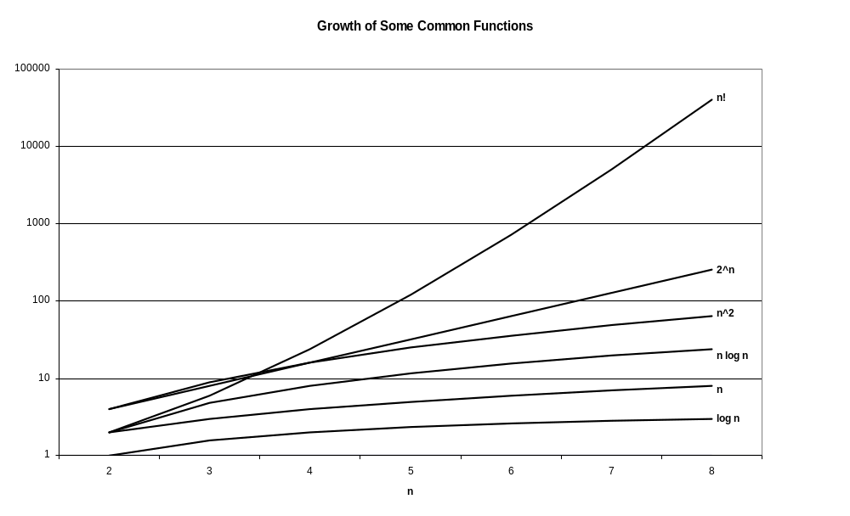

Slide 71
Sample growth rates and running times (sec)
Growth Rate | n = 1 | n = 10 | n = 100 | n = 1000
log n | 0 | 3.32 | 6.64 | 9.96
n | 1 | 10 | 100 | 1000
N log n | 0 | 33.2 | 664 | 9966
n ² | 1 | 100 | 10000 | 10 ⁶
n ³ | 1 | 1000 | 10 ⁶ | 10 ⁹
2 ^{n} | 2 | 1024 | 10 ³⁰ | 10 ³⁰⁰
n ^{n} | 1 | 10 ¹⁰ | 10 ²⁰⁰ | 10 ³⁰⁰⁰

Slide 72
Size Does Matter
What happens if we double the input size N?
N | log₂N | 5N | Nlog₂N | N² | 2^{N}
8 | 3 | 40 | 24 | 64 | 256
16 | 4 | 80 | 64 | 256 | 65536
32 | 5 | 160 | 160 | 1024 | ~10⁹
64 | 6 | 320 | 384 | 4096 | ~10¹⁹
128 | 7 | 640 | 896 | 16384 | ~10³⁸
256 | 8 | 1280 | 2048 | 65536 | ~10⁷⁶

Slide 73
Typical Growth Rates
C constant, we write O(1)
logN logarithmic
log²N log-squared
N linear
NlogN
N² quadratic
N³ cubic
2^{N} exponential
N! factorial

Slide 74
Size Does Matter?
Common Orders of Growth
O (k) = O (1) | Constant Time
O(log_{b}N) = O(log N) | Logarithmic Time
O(N) | Linear Time
O(N log N)
O(N²) | Quadratic Time
O(N³) | Cubic Time
--------
O(k^{N}) | Exponential Time
Increasing Complexity

Slide 75
How Running Time is Estimated?
An algorithm, in general, consists of
  Some initialization instructions
  Looping
  Decision-making
  Other ‘bookkeeping’ operations such as
    incrementing array indexes
    computing array indexes
    setting pointers in data structures etc.
Some of these tasks are independent of the size of inputs some are not
  e.g. number of loops may be influenced by the size of input
  execution time of one pass through a loop may be much more than the execution time in another pass
  One algorithm may have longer loop bodies than another algorithm for the same problem

Slide 76
How Running Time is Estimated?
It may not be good idea to measure the execution time by means of number of loops in an algorithm
So we will ignore initialization, loop control and other bookkeeping and just count the basic operations performed by an algorithm e.g.
  To multiply two matrices, the basic operation is multiplication
  To sort an array, the basic operation is the comparison of array elements
Thus the no. of basic operations involved in an algorithm is a good measure of the execution time of an algorithm and a good criterion for comparing several algorithms

Slide 77
How Does Memory Requirement matter?
To solve a certain problem, it is obvious that data are stored in main memory
Apart from this storage requirement, an algorithm may demand extra space as
  to store intermediate data
  Some data structure like stack/queue etc.
  As memory is expensive thing in computation, a good algorithm should solve a problem with as minimum as possible memory
    Processor – memory speed bottleneck
Memory run-time trade off
  We can reduce execution time by increasing memory usage or vice versa
  E.g. execution time of a searching algorithm over the array can be greatly reduced by using some other arrays to index elements in main arrays

Slide 78
Why Simplicity and Clarity is Considered?
A quantitative measurement in algorithm analysis
Algorithm is usually expressed in English like language or in a pseudo code so that it can be easily understood
This matters because it is then easy to analyze quantitatively analyze over other parameters such as
  Easy to implement (by a programmer)
  Easy to develop a better version or
  Modify for other purposes etc.

Slide 79
Concept of Optimality
It is observed that whatever be the clever procedure, we follow, an algorithm cannot be improved beyond a certain point
Three cases that may arise specific to an algorithm
  Best Case – minimum execution time
  Average Case – indicates the behavior of an algorithm in an average situation
  Worst Case – maximum execution time

Slide 80
Complexity
Execution time, memory requirement and optimality can be expressed quantitatively in term of size of input n.
Expressing the execution time in term of time say T(n) is the time complexity of an algorithm

Slide 81
Complexity Analysis
Best case analysis
  Given the algorithm and input of size n that makes it run fastest (compared to all other possible inputs of size n), what is the running time?
Worst case analysis
  Given the algorithm and input of size n that makes it run slowest (compared to all other possible inputs of size n), what is the running time?
    A bad worst-case complexity doesn't necessarily mean that the algorithm should be rejected.
Average case analysis
  Given the algorithm and a typical, average input of size n, what is the running time?

Slide 82
Summary
Any Questions?

